Slide 1
Data Preprocessing
Unit-2

Slide 2
Topics to be Covered
Need of Data preprocessing
Objectives of data preprocessing
Techniques of data preprocessing
Data cleansing
Data integration
Data transformation
Data Reduction
Data Discretization

Slide 3
Why Data Preprocessing?
Data in the real world is pure
incomplete: lacking attribute values, lacking certain attributes of interest
e.g., occupation=“ ”
noisy: containing errors or outliers
e.g., Salary=“-10”
inconsistent: containing discrepancies in codes or names
e.g., Age=“42” Birthday=“03/07/1997”
e.g., Was rating “1,2,3”, now rating “A, B, C”
e.g., discrepancy between duplicate records

Slide 4
Objectives of data preprocessing
To have quality data in warehouse.
Measures for data quality: A multidimensional view
Accuracy: correct or wrong, accurate or not
Completeness: not recorded, unavailable, …
Consistency: some modified but some not, dangling, …
Timeliness: timely update?
Believability: how trustable the data are correct?
Interpretability: how easily the data can be understood?

Slide 5
Why Is Quality of Data is poor?
Incomplete data may come from
“Not applicable” data value when collected
Different considerations between the time when the data was collected and when it is analyzed.
Human/hardware/software problems
Noisy data (incorrect values) may come from
Faulty data collection instruments
Human or computer error at data entry
Errors in data transmission
Inconsistent data may come from
Different data sources
Functional dependency violation (e.g., modify some linked data)
Duplicate records also need data cleaning
Incomplete data may come from
“Not applicable” data value when collected
Different considerations between the time when the data was collected and when it is analyzed.
Human/hardware/software problems
Noisy data (incorrect values) may come from
Faulty data collection instruments
Human or computer error at data entry
Errors in data transmission
Inconsistent data may come from
Different data sources
Functional dependency violation (e.g., modify some linked data)
Duplicate records also need data cleaning

Slide 6
Why Is Data Preprocessing Important?
No quality data, no quality mining results!
Quality decisions must be based on quality data
e.g., duplicate or missing data may cause incorrect or even misleading statistics.
Data warehouse needs consistent integration of quality data
Data extraction, cleaning, and transformation comprises the majority of the work of building a data warehouse

Slide 7
Major Tasks in Data Preprocessing
Data cleaning
Fill in missing values, smooth noisy data, identify or remove outliers, and resolve inconsistencies
Data integration
Integration of multiple databases, data cubes, or files
Data transformation
Normalization and aggregation
Data reduction
Obtains reduced representation in volume but produces the same or similar analytical results
Data discretization
Part of data reduction but with particular importance, especially for numerical data
Data cleaning
Fill in missing values, smooth noisy data, identify or remove outliers, and resolve inconsistencies
Data integration
Integration of multiple databases, data cubes, or files
Data transformation
Normalization and aggregation
Data reduction
Obtains reduced representation in volume but produces the same or similar analytical results
Data discretization
Part of data reduction but with particular importance, especially for numerical data

Slide 8
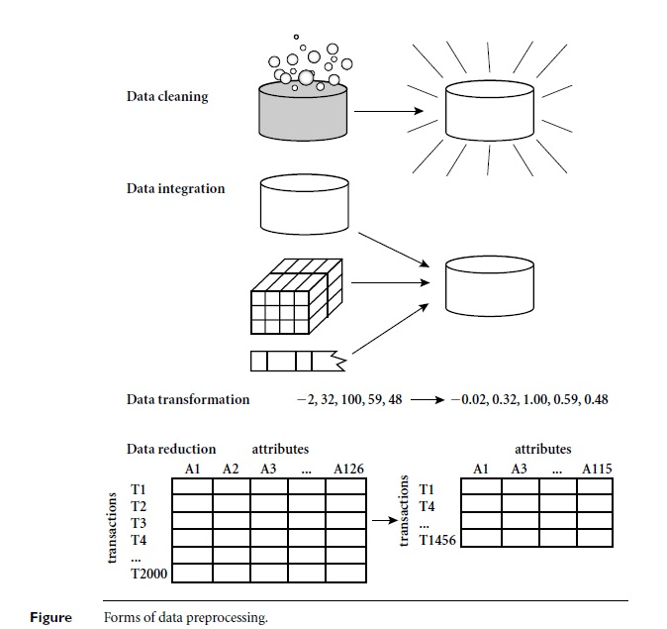
Forms of Data Preprocessing

Slide 9
Important points
Outliers:-an outlier as an observation in a data set which appears to be inconsistent with the remainder of that set of data.

Slide 10
Techniques of data preprocessing
Techniques of data preprocessing
Data cleansing
Data integration
Data transformation
Data Reduction
Data Discretization

Slide 11
Data Cleaning
Importance
“Data cleaning is one of the three biggest problems in data warehousing”—Ralph Kimball
“Data cleaning is the number one problem in data warehousing”—DCI survey http://www.dciexpo.com/customer/aboutdci.htm
Data cleaning tasks
Fill in missing values
Identify outliers and smooth out noisy data
Correct inconsistent data
Resolve redundancy caused by data integration

Slide 12
Data Cleaning
Data cleaning routines work to “clean” the data by filling in missing values, smoothing noisy data, identifying or removing outliers, and resolving inconsistencies.
If users believe the data is impure, they will not trust the results of any data mining that has been applied to it. Also, impure or incorrect data can cause confusion for the mining procedure, resulting in unreliable output.
Therefore, a useful preprocessing step is used in data-cleaning routines.

Slide 13
Handling Missing Values
If there are many tuple (record)having no recorded value then we can use various method given below to fill missing values.
Ignore the tuple:
Fill in the missing value manually:
Use a global constant to fill in the missing value
Use the attribute mean to fill in the missing value
Use the attribute mean for all samples belonging to the same class as the given tuple:

Slide 14
Handling Missing Values (contd…)
Ignore the tuple: This method is not very effective, unless the tuple contains several attributes with missing values. It is especially poor when the percentage of missing values per attribute varies considerably.
Fill in the missing value manually: This approach is time-consuming and may not be feasible given a large data set with many missing values.
Use a global constant to fill in the missing value: Replace all missing attribute values by the same constant, such as a label like “Unknown”.

Slide 15
Handling Missing Values (contd…)
Use the attribute mean to fill in the missing value: For example, suppose that the average income of customers is $56,000. This value to used to replace the missing value for income.
Use the attribute mean for all samples belonging to the same class as the given tuple: For example, if classifying customers according to credit risk, replace the missing value with the average income value for customers in the same credit risk category as that of the given tuple.

Slide 16
Handling Noisy Data
Noise is a random error or variance in a measured variable.
Binning Method
Clustering Method
Combined Computer and Human Inspection
Regression Method

Slide 17
Handling Noisy Data (contd…)
Binning Method:-
Binning methods smooth a sorted data value by consulting its “neighborhood,” that is, the values around it.
The sorted values are distributed into a number of “buckets,” or bins.
In smoothing by bin means, each value in a bin is replaced by the mean value of the bin.
Smoothing by bin medians can be employed, in which each bin value is replaced by the bin median.
In smoothing by bin boundaries, the minimum and maximum values in a given bin are identified as the bin boundaries. Each bin value is then replaced by the closest boundary value

Slide 18
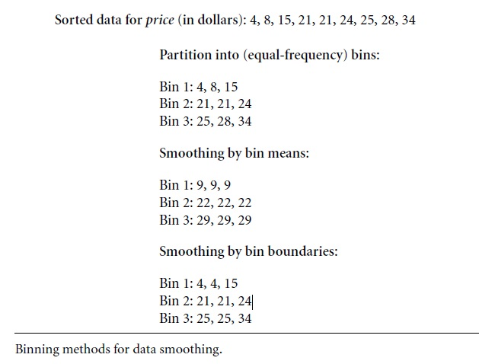
Handling Noisy Data (contd…)

Slide 19
Handling Noisy Data (contd…)
Clustering Method:-
Outliers may be detected by clustering, where similar values are organized into groups, or “clusters.” Intuitively, values that fall outside of the set of clusters may be considered outliers.

Slide 20
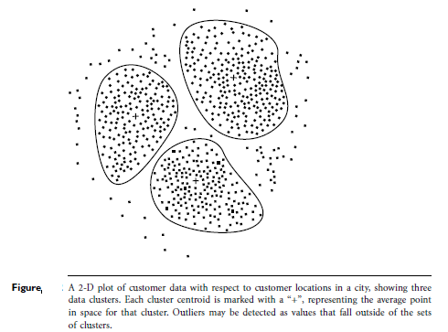
Handling Noisy Data (contd…)

Slide 21
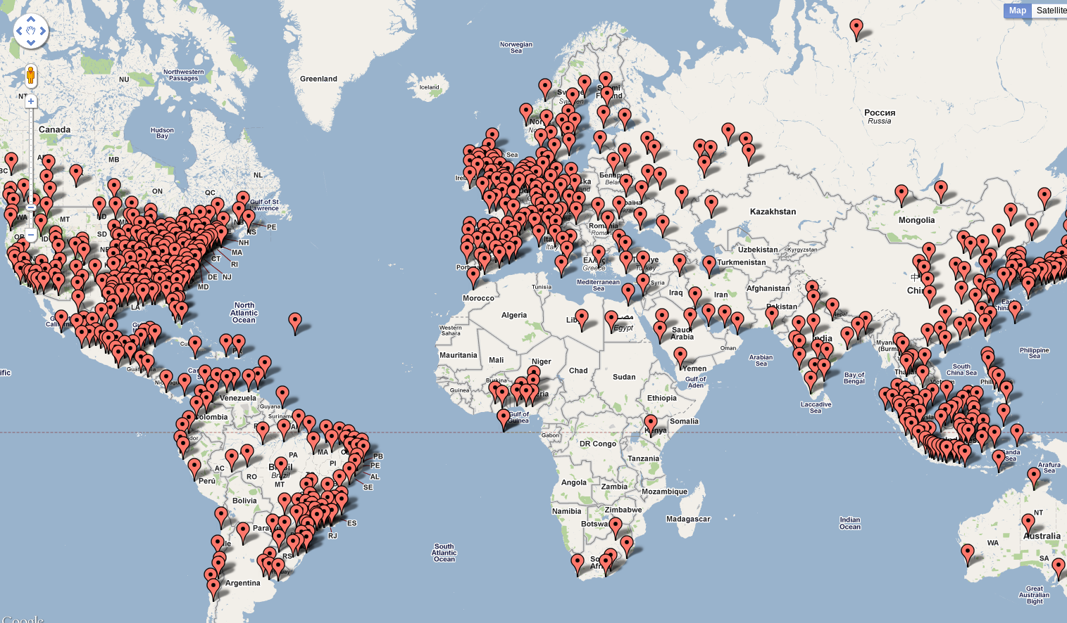
Handling Noisy Data
Twitter data mining and clustering results
Twitter data mining and clustering results
Source:http://tom.londondroids.com/2011/02/twitter-data-mining-and-clustering-results/

Slide 22
Handling Noisy Data
Regression Method :
Data can be smoothed by fitting the data to a function, such as with regression.
Linear regression involves finding the “best” line to fit two attributes (or variables), so that one attribute can be used to predict the other.
Multiple linear regression is an extension of linear regression, where more than two attributes are involved and the data are fit to a multidimensional surface.

Slide 23
Data Integration
Data integration:
Combines data from multiple sources into a coherent store
Schema integration: e.g., A.cust-id ≡ B.cust-#
Integrate metadata from different sources
Entity identification problem:
Identify real world entities from multiple data sources, e.g., Bill Clinton = William Clinton
Detecting and resolving data value conflicts
For the same real world entity, attribute values from different sources are different
Possible reasons: different representations, different scales
e.g., metric vs. British units

Slide 24
Data Integration
Data integration involves integrating data from multiple databases, data cubes, or files.
Some attributes representing a given concept may have different names in different databases, causing inconsistencies and redundancies. For example, the attribute for customer identification may be referred to as customer_id in one data store and cust_id in another.

Slide 25
Data Integration
Naming inconsistencies may also occur for attribute values.
Having a large amount of redundant data may slow down or confuse the knowledge discovery process.
Additional data cleaning can be performed to detect and remove redundancies that may have resulted from data integration.

Slide 26
Data Transformation
Data transformation operations, such as normalization and aggregation, are additional data preprocessing procedures that would contribute toward the success of the mining process.
Normalization: Normalization is scaling the data to be analyzed to a specific range.
Aggregation: Also, it would be useful for data analysis to obtain aggregate information such as the sales per customer region. As, it is not a part of any pre-computed data cube, it would need to be computed. This process is called Aggregation.

Slide 27
Data Reduction
Why data reduction?
A database/data warehouse may store terabytes of data.
Complex data analysis/mining may take a very long time to run on the complete data set.
Data reduction
Obtain a reduced representation of the data set that is much smaller in volume but yet produce the same (or almost the same) analytical results

Slide 28
Data Reduction
Obtain a reduced representation of the data set that is much smaller in volume but yet produce the same (or almost the same) analytical results
There are a number of strategies for data reduction.
Data Aggregation
Attribute Subset Selection
Dimensionality Reduction
Numerosity
Generalization
Data Discretization

Slide 29
Data Reduction
Data Aggregation (e.g., building a data cube),
Attribute Subset Selection (e.g., removing irrelevant attributes through correlation analysis),
Dimensionality Reduction (e.g., using encoding schemes such as minimum length encoding)
Numerosity Reduction (e.g., “replacing” the data by alternative, smaller representations such as clusters or parametric models).
Generalization with the use of concept hierarchies, by organizing the concepts into varying levels of abstraction.
Data Discretization is very useful for the automatic generation of concept hierarchies from numerical data.

Slide 30
Thank You

